Slide 1
College Planning for Juniors
Fort Collins High School Class of 2025

Slide 2
Agenda
Phase 1: What To Do Now (April – May)
SAT/ACT School and National Testing Opportunities
Exploring College Fit Factors
College Representative Visits to FCHS
PSD Case Study & College Fair
Phase 2: Summer Planning (June – July)
Common Application
Visiting College Campuses
Creating a Balanced List
Poudre School District College Boot Camp
Phase 3: Senior Year (August – September)
Academic Scheduling Expectations
ASCENT & TREP Applications
FAFSA & CASFA Processes
FRCC & AP Class Transcripts

Slide 3
What To Do Now
SAT & ACT National Testing
The Colorado state SAT will be offered to all juniors on Tuesday, April 16th at Fort Collins High School
The April 2024 testing will be an electronic format (2 hrs. 14 mins)
Reading and Writing – 64 minutes
Math – 70 minutes
Students may take the SAT as national testing centers, including Windsor Charter Academy.
$60 registration fee
Score reporting options for the 2024-2025 admissions cycle
Test Optional Details – Colorado Schools
FairTest – list of test-optional colleges

Slide 4
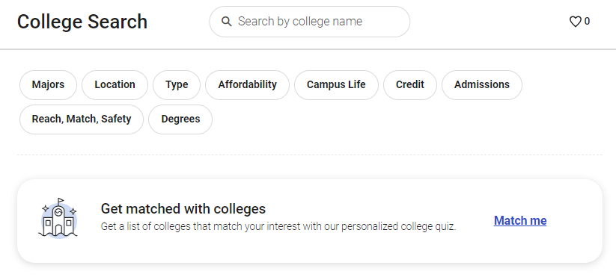
College Fit Factors
How do you start finding colleges and universities that best fit you?
Public vs. Private
Financial Aid Opportunities / Loans
Location, Location, Location
Size
Diversity, Accessibility, & Climate
Research / Internship Opportunities
College Board Big Future
The Princeton Review Find Your College
Xello College Exploration

Slide 5
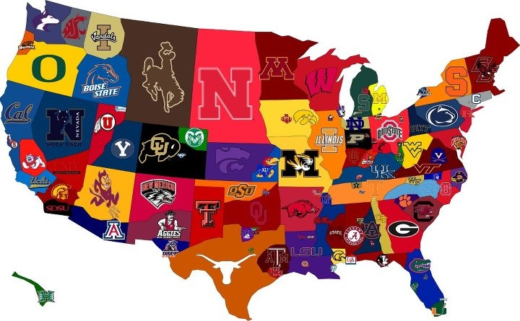
College Representative Visits
Opportunity to visit with college admissions officers (the same staff members that read your college applications!)
Free in-person interview
Select schools admit students on the spot
Excused from academic classes during visits

Slide 6
PSD Case Study & College Fair
When: Thursday, April 18th
Where: Timnath Middle/High School
College Fair: 6:00 – 6:30 p.m.
Case Study: 6:30 – 8:00 p.m.

Slide 7
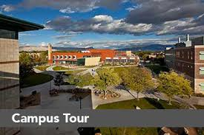
Summer Planning
Begin the Common Application
Common App Ready feature for planning purposes
Visit campuses & ask questions!
Update your college list
Attend the Poudre School District College Planning Camp (August 2024)

Slide 8
The Common Application
The 24-25 Common Application launches on August 1st, 2024
Essay prompts will remain the same for the 2024-2025 cycle.
Some students have a background, identity, interest, or talent that is so meaningful they believe their application would be incomplete without it. If this sounds like you, then please share your story.
The lessons we take from obstacles we encounter can be fundamental to later success. Recount a time when you faced a challenge, setback, or failure. How did it affect you, and what did you learn from the experience?
Reflect on a time when you questioned or challenged a belief or idea. What prompted your thinking? What was the outcome?
Reflect on something that someone has done for you that has made you happy or thankful in a surprising way. How has this gratitude affected or motivated you?
Discuss an accomplishment, event, or realization that sparked a period of personal growth and a new understanding of yourself or others.
Describe a topic, idea, or concept you find so engaging that it makes you lose all track of time. Why does it captivate you? What or who do you turn to when you want to learn more?
Share an essay on any topic of your choice. It can be one you've already written, one that responds to a different prompt, or one of your own design

Slide 9
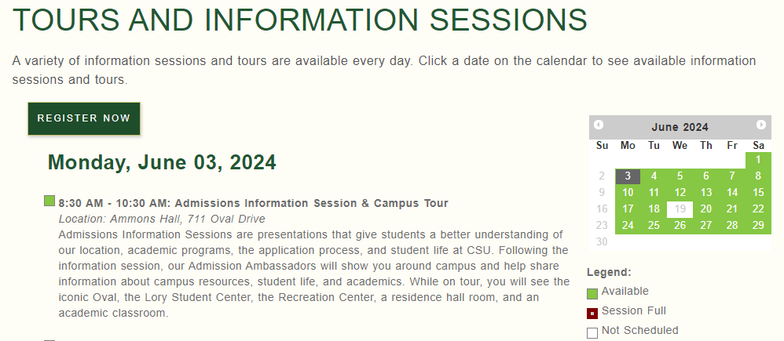
Campus Visits
Available each day of the week during June and July
Students may register through college admissions sites
Explore college and universities that align with “college fits”

Slide 10
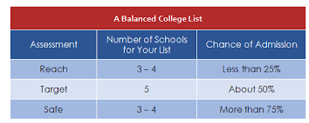
Creating a Balanced List
To include:
Safety schools
Target Schools
Reach Schools
No magic number of schools; however, most students apply to 5-7 schools (Not 57).
Keep your list fluid, as factors will change with financial aid offers, scholarship opportunities, and events taking place during senior year.

Slide 11
Senior Year (Aug / Sept)
Schedule a Senior Meeting
Letters of Recommendation
Transcript Request Forms
Financial Aid (Scholarships, Grants, FAFSA / CASFA)
Senior Meeting (all seniors)
Senior Year College Planning Evening

Slide 12
Senior Year Factors: It Still Counts!
Colleges do consider fall grades
Keep your schedule competitive
Many colleges will ask for final grades
Senior coursework serves as a foundation for college preparation, not as a time to “take it easy.”
Stay current in English and math curriculum
Social media influences
28% of college admissions officers actively look at applicants’ social media profiles during the assessments
Keep your student resume updated for academic and professional opportunities

Slide 13
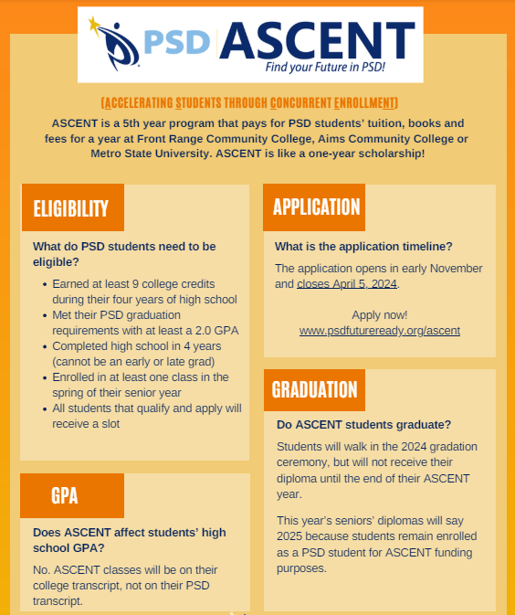
PSD Financial Opportunities
ASCENT Program
9 or more college credits
2.0 or higher GPA
Meet all PSD graduation standards
TREP Program
College credit for concurrent enrollment classes

Slide 14
College Preparation Quiz
What percentage of colleges and universities will remain test optional for the 2024-2025 admissions cycle?
How long does the average admissions officer spend reviewing your college application?
Who should I ask for a letter of recommendation?
What was the first college in the state of Colorado?
Which university claims to be the oldest institution of higher education in the United States?

Slide 15
Fort Collins High School Resources
College Application Process
College Visits: What to Do & What to Ask
Questions to Ask College Representatives
Paying for College

