Slide 1
Applying to College Class of 2025
FCHS Student Services

Slide 2
Agenda
Creating a Balanced List
The Application Process at FCHS
The Common Application
Components of an Application
Financial Aid Timelines and Factors
College Visits
ASCENT & TREP Programs
Other Items

Slide 3
Creating a College List
Safety, Target, & Reach Schools
3-7 Schools, not 37 schools
Exploration with Big Futures, Xello, & Niche
Academic, Social, and Financial Fit for You

Slide 4
Terminology
Common Application, Coalition Application, UC Application
Regular Decision
Early Action
Early Decision
Rolling Admissions
Deferred Admissions
Waitlist
GPA

Slide 5
College Application Process At FCHS

Slide 6
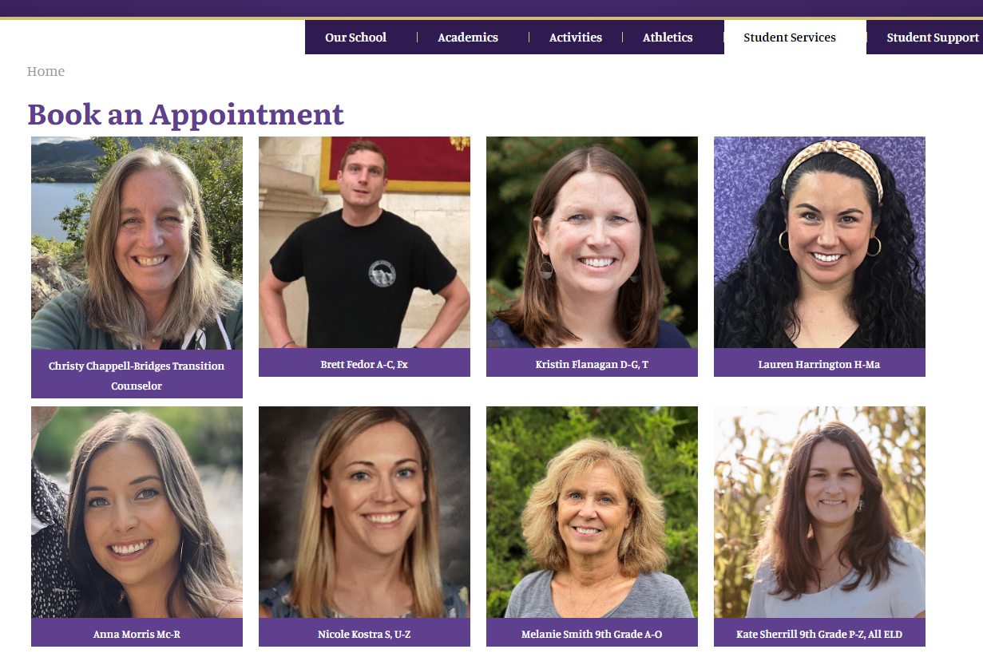
Senior Meeting
Schedule a meeting with your counselor during the first or second quarter
Discuss post-secondary plans, individual timelines, & tasks
Schedule directly with your counselor or with Leanne Jones, Student Services Secretary
Book an Appointment

Slide 7
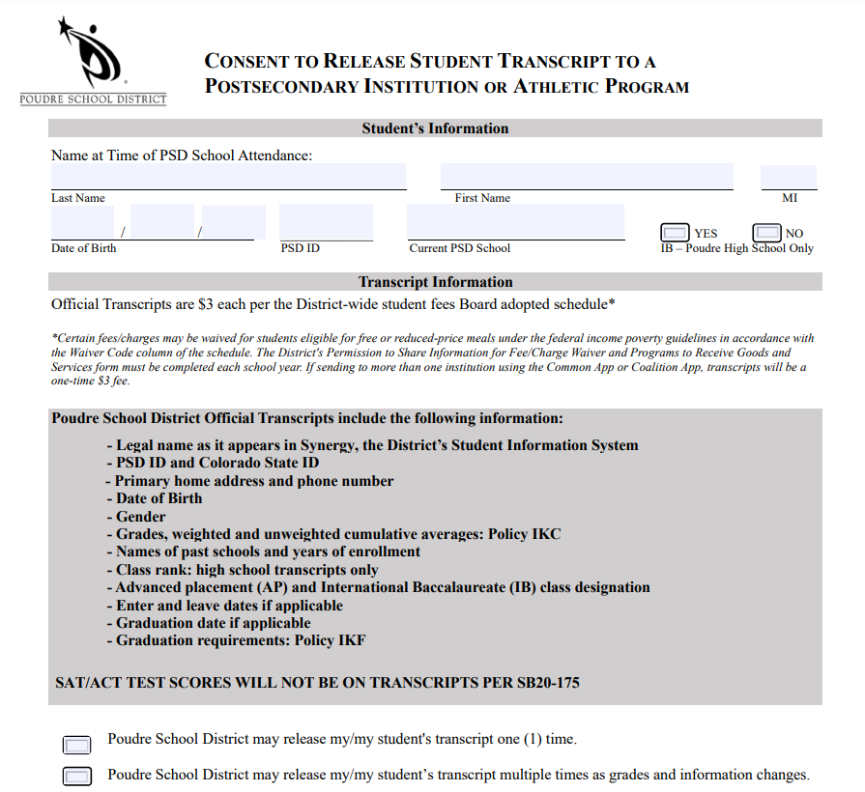
Ordering Official Transcripts
Transcript Request Form
Available on the Counselor website, hardcopies in Student Services
Complete form with student & parent/guardian signatures
List all colleges on the back. If applying via the CA, only list one school
Pay $3 fee – FCHS Bookkeeper or School Pay
Return completed form & receipt to Shannon Dunlap in Student Services

Slide 8
Letters of Recommendation
Check requirements for each college, including # required, subject area, etc.
1 letter is common, 2 is the most
Teacher vs. Counselor Letter of Recommendation
Who do I ask?
Give AT LEAST two weeks’ notice
Complete the Academic Profile (available in Student Services
Invite your recommender(s) through the Common Application
My Colleges > Recommenders & FERPA

Slide 9
The Common Application
Use if applying to two or more Common Application colleges
Additional requirements for each college
Submit individually to each college

Slide 10
The Common Application Dashboard

Slide 11
Application Requirements

Slide 12
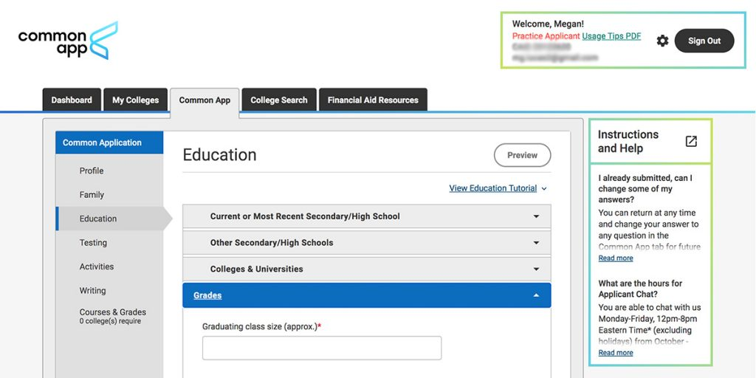
Common Application: Education Section
Senior Class Size: 426
Rank: exact rank, weighted (StudentVue > Course History)
GPA Scale: 4.00
Cumulative GPA: use weighted GPA, and report that it’s weighted
Counselor’s contact information can be found in the Student Services website

Slide 13
Common Application: Counselor Information

Slide 14
Reporting Test Scores
Test Optional vs. Test Blind
Official Test Scores ordered through College Board (SAT)
Test Optional Details for Colorado Colleges
FairTest – list of test-optional colleges

Slide 15
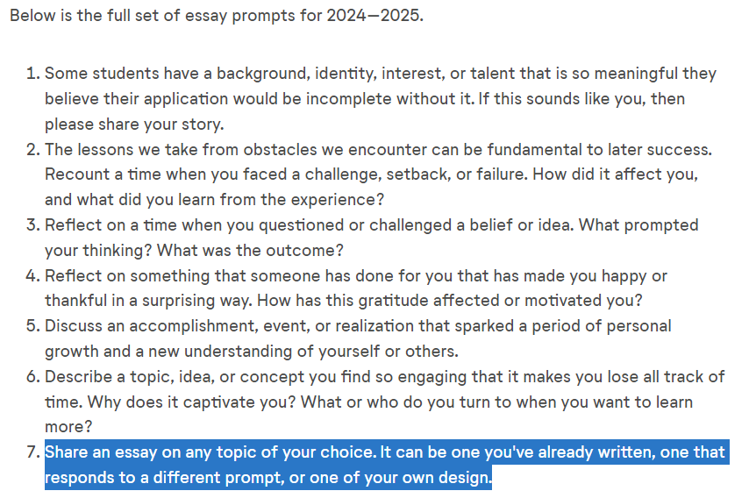
Personal Essay & Writing Supplements
Personal essay is required by many colleges
Found under the Writing section on the Common Application
Seven prompts available, must choose one
750-word limit
Writing Section – shows which colleges require, can still submit if “optional”
Writing Supplement – required by some colleges
My Colleges > Questions > Writing
Proofread, grammar check, and repeat with a second set of eyes

Slide 16
Poudre School District COSI Support
Ms. Jennifer Musci
COSI Grant Coordinator
jmusci@psdschools.org

Slide 17
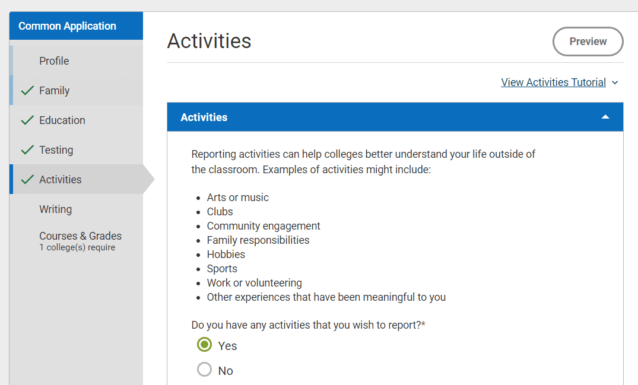
Extracurricular Activities
Quality over Quantity
Highlight interests & leadership opportunities
List up to 10 activities
Examples: arts, clubs, community engagement, family responsibilities, sports, work, volunteering
Did you know? If you need more space to elaborate on an activity or experience, you can use the Additional Information question in the Writing section to share more details.

Slide 18
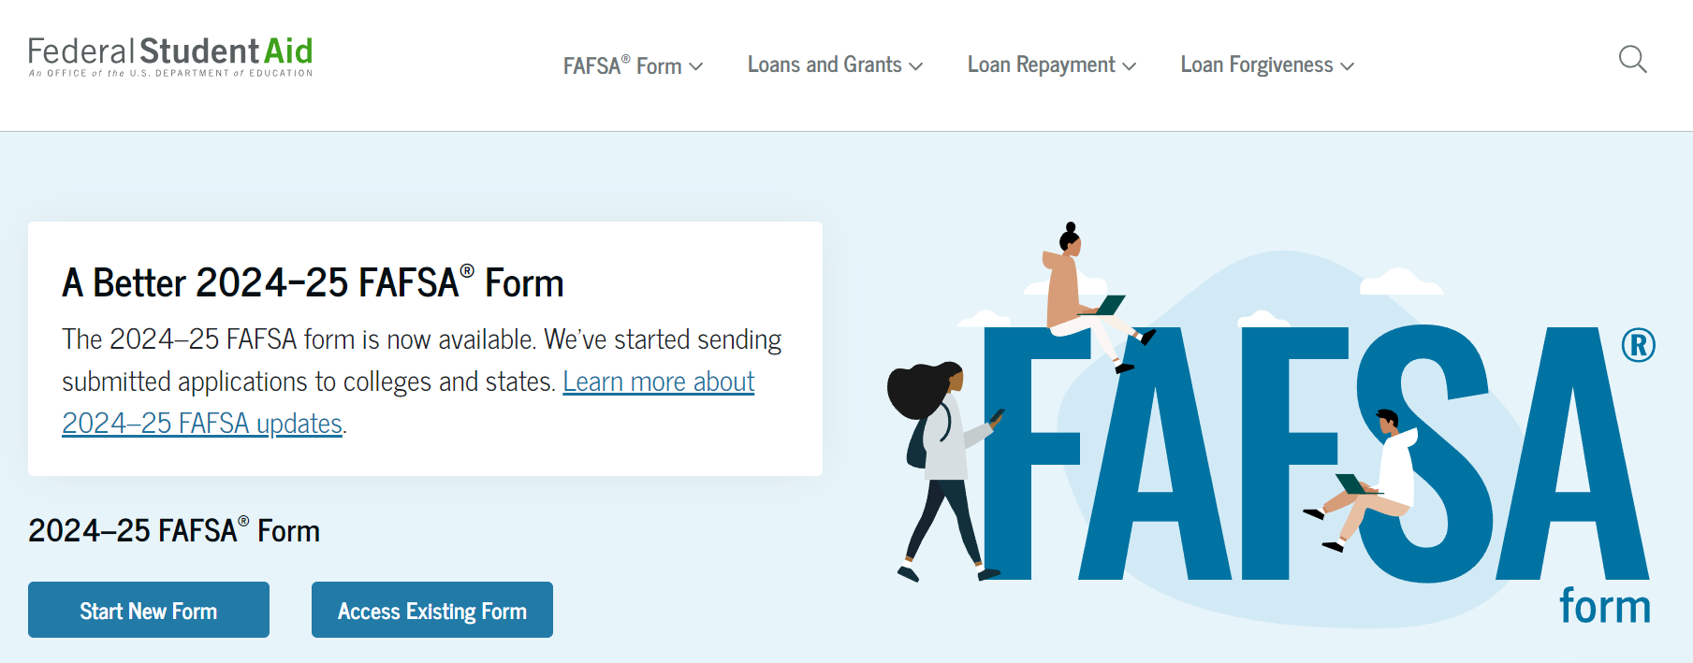
Financial Aid Opportunities
Free Application for Federal Student Aid (FAFSA)
Available on December 1st, 2024
Colorado Application for State Financial Aid (CASFA) for non-US citizens & non-residents
College Opportunity Fund (COF)
CSS Profile – required by some colleges
WUE – interstate tuition savings program

Slide 19
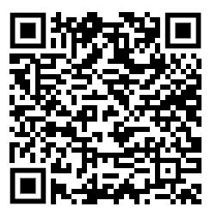
FAFSA Timeline
Completion Rate through August 2024
Nationally: 51.0%
Colorado: 42.4%
Federal Student Aid ID Account Worksheet and Guide

Slide 20
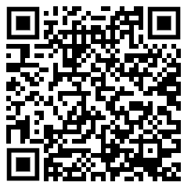
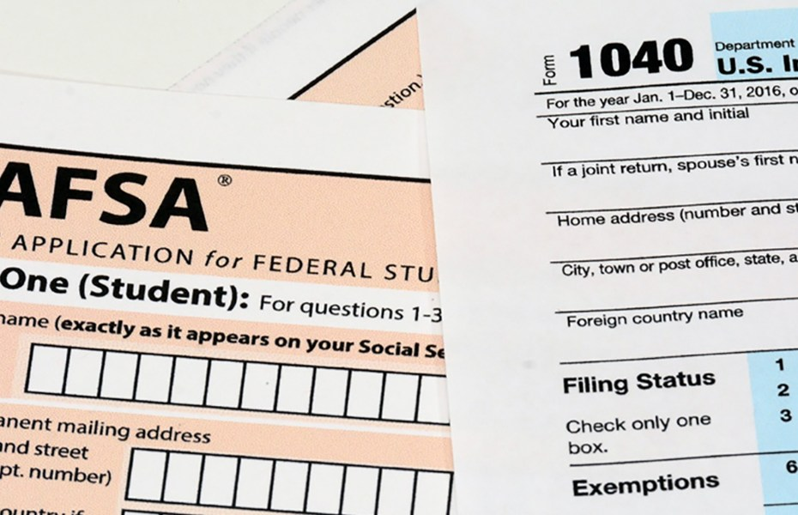
FAFSA Continued.
2025-2026 FAFSA Prototype Now Available
Allows users to navigate specific scenarios
Visit fsapartners.ed.gov/fafsa-prototype/2526
Enter the access code: prototype2526

Slide 21
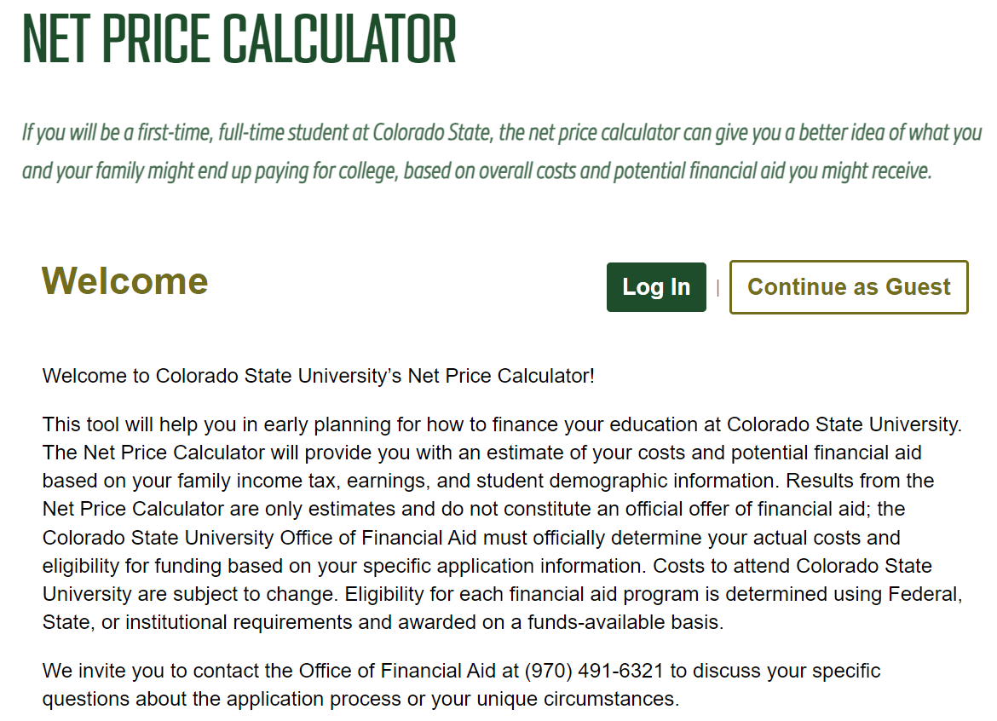
Additional Financial Aid Tools
Net Price Calculator (NPC) – available on college websites
Institutional Scholarships (Merit Aid)
Local Scholarships – updated on Xello
The PSD Scholarship Packet will be available in December 2024
National Scholarships – see “the wall” or resources slide
Award letters announced in the Spring

Slide 22
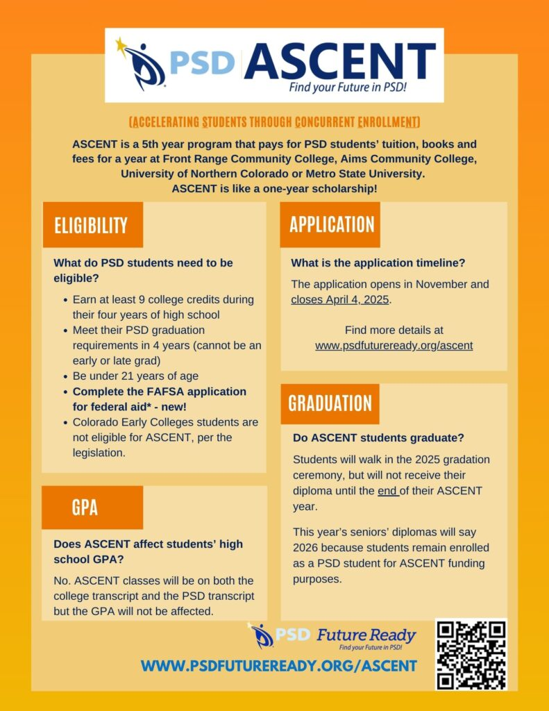
ASCENT & TREP District Programs
Accelerating Students through Concurrent Enrollment (ASCENT)
5th-year high school program
Full year of classes at FRCC, AIMS, or UNC – paid for by the district!
Qualification – at least 9 post-secondary credit hours
Application available late fall for current seniors
Teacher Recruitment Education & Preparation (TREP)
5th & 6th year high school program for future educators
Full year of classes at FRCC, AIMS, or UNC
Successful completion of 1 college course from educator pathway during 12th grade

Slide 23
Fort Collins High School Senior Timeline
September – October
Continue researching colleges – FCHS visits, college fairs, campus tours, online
Out of State College Fair: September 24th, Poudre High School from 6:00 PM – 7:30 PM
In State College Fair: October 23rd, Fossil Ridge High School from 6:00 PM -7:30PM
Colorado Free Application Days!
October 15th-17th
Applying ED/EA: request documents at least 2 weeks before your first deadline

Slide 24
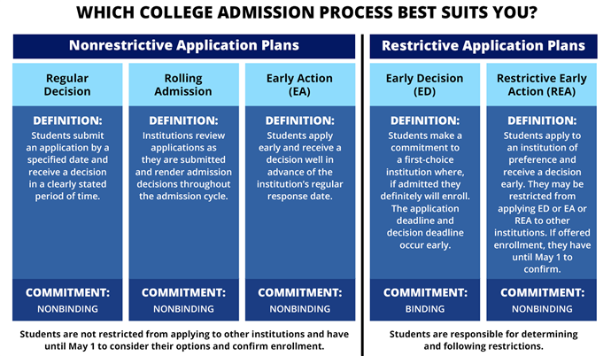
Quarter Two
November
Submit early applications (EA/ED)
Continue to challenge yourself academically!
December
Complete applications for Regular Decision
FAFSA Applications open on December 1st
Scholarships!
PSD Scholarship application
Thank you notes to teachers – recommendations
Decision letters for early applications

Slide 25
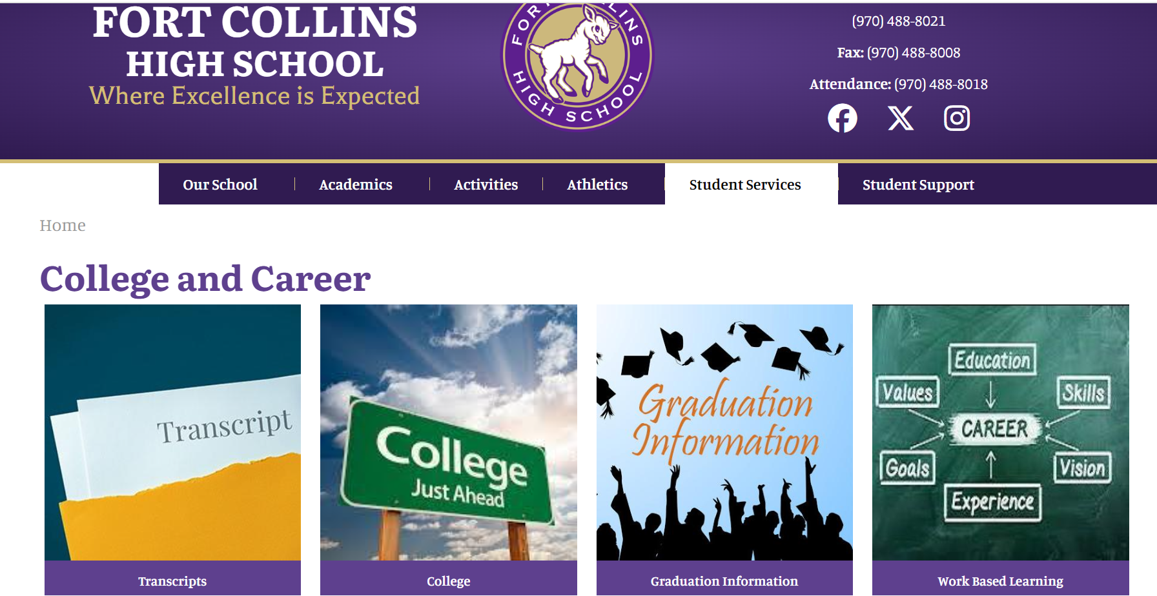
Other Items
FRCC credit – request official transcript to send to 4-year college (eWolf account)
AP scores – request scores from College Board
May 1st – national deposit day
Your counselor is here to help!

Slide 26
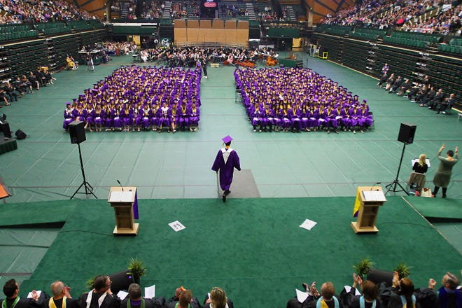
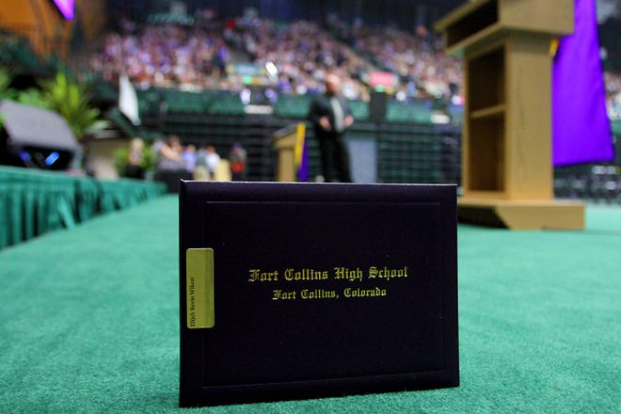
Senior Year Factors: It Still Counts!
College do consider fall grades
Keep your schedule competitive
Many colleges will ask for final grades
Senior coursework serves as a foundation for college preparation, not as a time to “take it easy.”
Stay current in English and math curriculum

Slide 27
Contact Information
Nicole Kostra
School Counselor
nkostra@psdschools.org / 970-488-8103
Brett Fedor
School Counselor
bfedor@psdschools.org / 970-488-8109
Shannon Dunlap
College & Career Coordinator
shannond@psdschools.org / 970-488-8111

