Slide 1


Applying to College
FCHS Class of 2024
Notes:
Brett

Slide 2
Agenda
Creating a balanced list
The process at FCHS
The Common Application
Components of an application
Financial Aid
Timeline
College Visits
ASCENT/TREP
Other Items
Notes:
Brett

Slide 3


“You’re off to great places! Today is your day!
Your mountain is waiting, so get on your way!
-Dr. Seuss
Notes:
Brett

Slide 4

Creating a college list
Safe, reach schools
3-7, not 37
Exploration with Big Futures link
Academic, social, and financial fit
Notes:
Brett

Slide 5
Terminology
Common Application, Coalition
Regular Decision
Early Action
Early Decision
Rolling Admissions
Deferred Admissions
Waitlist
GPA
Notes:
Nicole
Applying to CSU

Slide 6

College Application Process at FCHS
Notes:
Nicole

Slide 7
Senior Meeting
Schedule meeting with your counselor before 11/1
Discuss post-secondary plans and individual timelines & tasks
Schedule directly with counselor or with Leanne Jones, Student Services Secretary
  Book an Appointment
Notes:
Nicole

Slide 8
Official Transcripts
Transcript request form (Counseling website, hardcopies in Student Services)
Complete form (student & parent signature)
List all colleges on back of form even if applying via Common App
Pay fee $3 fee- FCHS Bookkeeper or School Pay
Return completed form & receipt to Shannon Dunlap in Student Services
Notes:
Nicole

Slide 9

Letters of Recommendation
Check requirement for each college (# required, subject area, etc.)
Teacher vs. Counselor L of R
  Who do I ask?
Give AT LEAST two weeks' notice
Complete Academic Profile Sheet (website & Student Services)
Invite recommenders through the Common Application (My Colleges>Click on College>Recommenders & FERPA)
  Must complete FERPA release first
Notes:
Nicole

Slide 10

If applying to two or more Common App colleges
Additional requirements for each college
Submit individually to each college
This Photo by Unknown author is licensed under CC BY-NC-ND.
Notes:
Brett

Slide 11
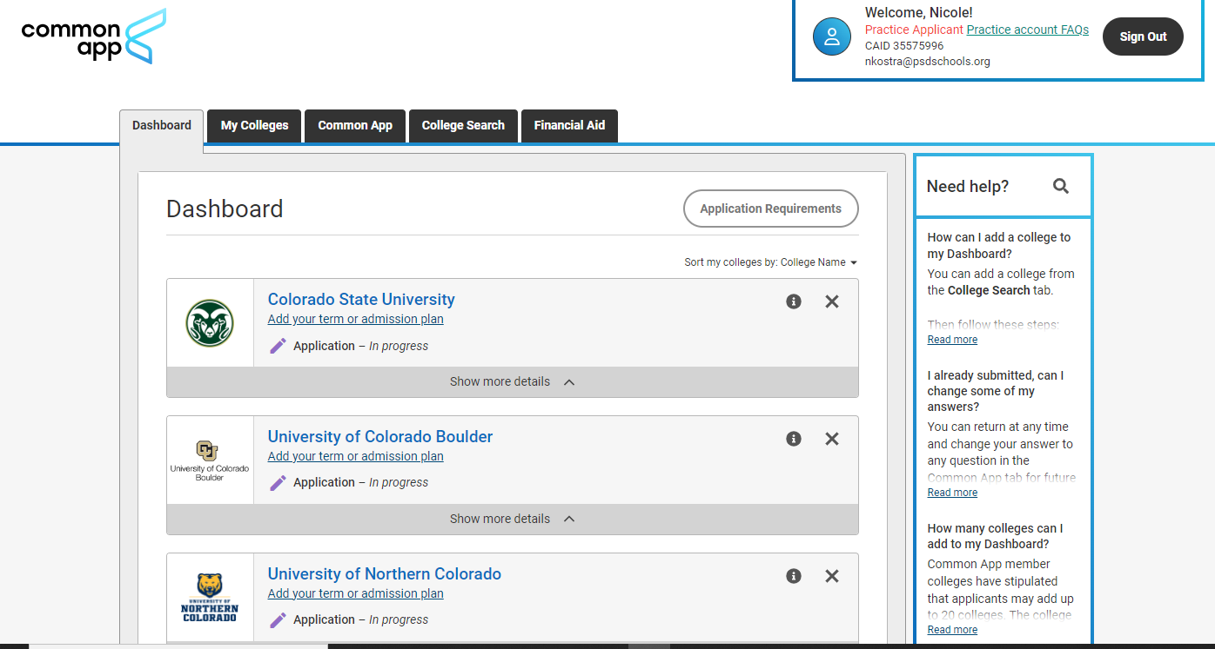
The Common App Dashboard
Notes:
Brett

Slide 12
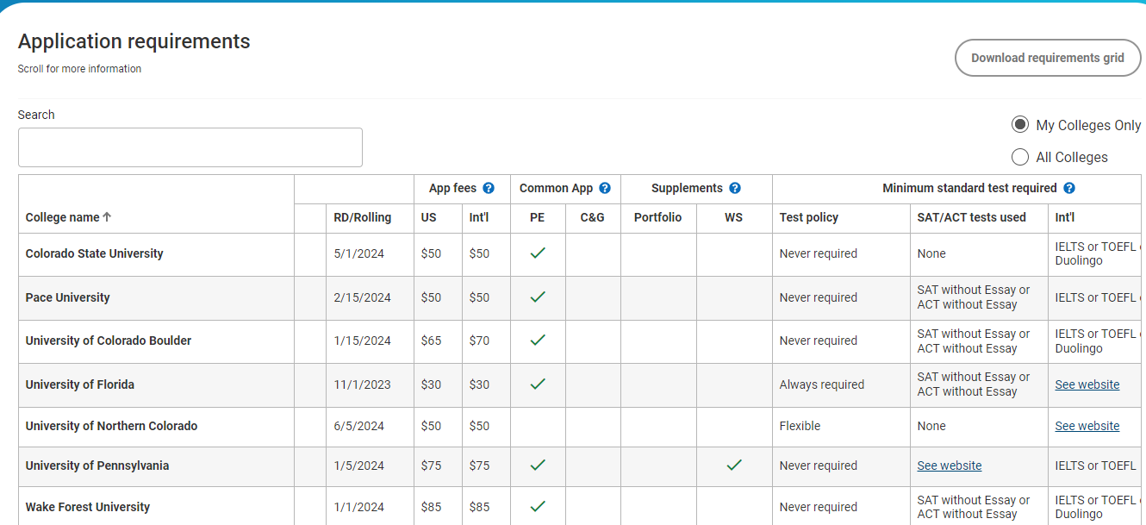
Notes:
Brett

Slide 13
Common App- Education
Senior class size: 450
Rank: exact rank, unweighted (StudentVue > Course History)
GPA scale: 4
Cumulative GPA: adjusted cumulative GPA, unweighted
Your counselor's contact information can be found on our website
  Counseling Team
Notes:
Brett

Slide 14
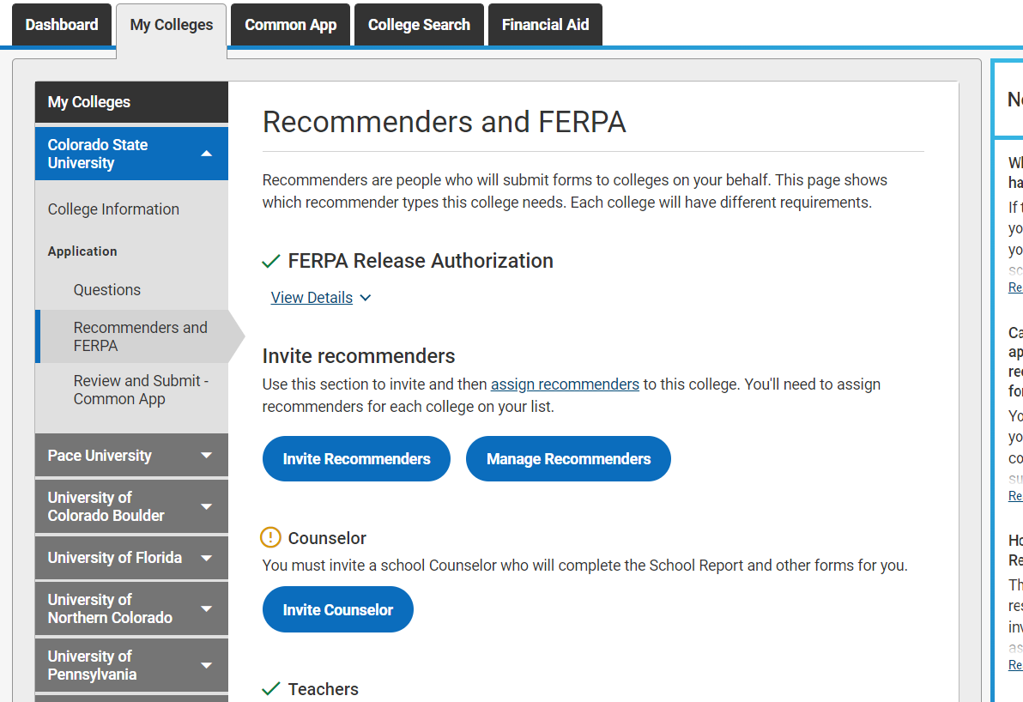
Counselor Information (emails)
Notes:
Brett

Slide 15

Test Scores
Test optional – admissions and/or merit aid
Official test scores – College Board (SAT)
Test Optional Details - CO Colleges
FairTest - list of test-optional colleges
Notes:
Nicole

Slide 16
Personal Essay& Writing Supplements
Personal Essay required by many colleges
Writing section on the Common App
6 prompts, choose 1 (or topic of your choice)
Writing section – shows which colleges require, can still submit if optional
Writing Supplement – required by some colleges
  My Colleges > Questions > Writing
  Or, My Colleges > Writing Supplement
Optional writing? Do it!
Proofread, grammar, second set of eyes
Notes:
Nicole

Slide 17
Extracurricular Activities
Quality over quantity
Highlight interests & leadership
List up to 10 on Common App
Ex: arts, clubs, community engagement, family responsibilities, hobbies, sports, work, volunteering
Notes:
Nicole

Slide 18
Financial Aid
FAFSA - Free Application for Federal Student Aid
  Available December 2023
CASFA – CO Application for State Financial Aid: non-US citizens and non-residents (ASSET)
College Opportunity Fund (COF)
CSS Profile - required by some colleges
Notes:
Brett

Slide 19
Financial Aid cont.
Net Price Calculator (NPC) - college website
Institutional Scholarship (Merit Aid) – often qualify through applying to the college
Local Scholarships – updated on Xello
National Scholarships – see "the wall" or resources slide
Award letters – spring
Notes:
Brett

Slide 20
ASCENT & TREP
Accelerating Students through Concurrent Enrollment (ASCENT)
  5th-year high school program
  Full year of classes at FRCC or AIMS – paid for by the district!
  Qualification – at least 9 post-secondary credit hours
  Application available late fall for current seniors
Teacher Recruitment Education & Preparation (TREP)
  5th & 6th year high school program for future educators
  Full year of classes at FRCC of AIMS
  Successful completion of 1 college course from educator pathway during 12th grade
Notes:
Nicole

Slide 21
CO Community College System
Career Advance Colorado
Zero-cost training for in demand jobs
Care Forward CO
Healthcare programs
Expires Spring 2024
Notes:
Nicole

Slide 22

General Timeline
Notes:
Brett

Slide 23
October
Continue researching colleges – FCHS visits, college fairs, campus tours, online
In State College Fair: October 23rd, FRHS from 6:00-7:30PM
Colorado Free Application Days!
  October 17th-19th
Applying ED/EA: request documents at least 2 weeks before your first deadline
Notes:
Brett

Slide 24
November
December
Submit early applications (EA/ED)
Continue to challenge yourself academically!
Complete applications for Regular Decision
Scholarships!
  PSD Scholarship application
Thank you notes to teachers – recommendations
Decision letters for early applications
Notes:
Brett

Slide 25
Other items
FRCC credit – request official transcript to send to 4-year college (eWolf account)
AP scores – request scores from College Board
May 1st – national deposit day
Your counselor is here to help!
Notes:
Nicole

Slide 26

Questions

Slide 27

We appreciate your feedback!

Slide 28
Resources
College Search
The Common Application
Coalition Application
Scholarships
CASFA – CO Application for State Financial Aid: non-US citizens and non-residents (ASSET)
College Opportunity Fund (COF)
College Visits @ FCHS
Others
  Niche: some colleges now accepting students from profile info (no application)
  BigFuture

